Slide 1
Mantid Demonstration
Nick Draper
12/09/2008

Slide 2
What will Mantid do?
Mantid
  Manipulation and Analysis Toolkit for ISIS Data
Aims
  To provide a framework for Data Analysis that is not instrument or technique/dependent.
  Support multiple target platforms (Windows, Linux).
  Easily extensible by Instruments Scientists/Users.
  Freely redistributable to visiting scientists.
  Provide low-level functionalities for Scripting, Visualization, Data transformation, Implementing Algorithms, Virtual Instrument Geometry.

Slide 3
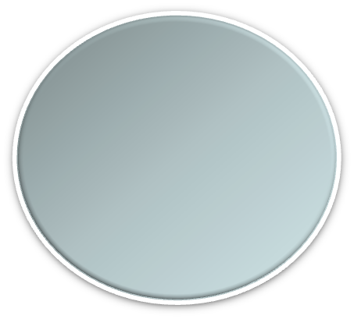
Architectural Design - Overview
Instrument log files
MantidScript
Command line & Scripting interface
RAW data files
Mantid Framework
API
Standard Algorithms
User Defined Algorithms
MantidPlot Graphing and analysis
NEXUS data files
Matlab Interface
DAE direct access
Future Instrument specific UI
Future Instrument specific UI

Slide 4
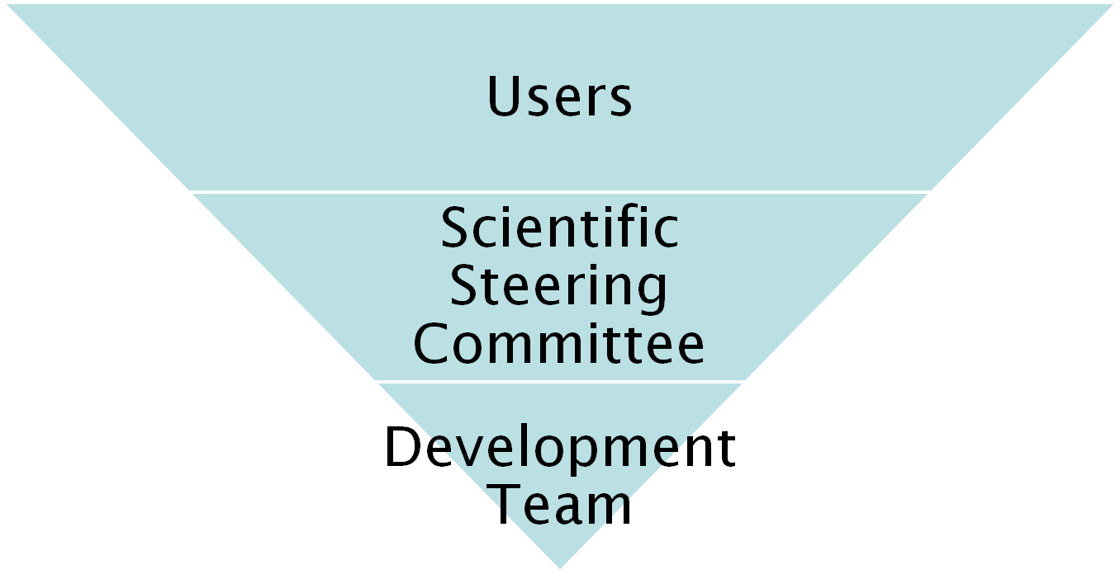
Project Organisation

Slide 5
Software led by Scientists
This is project is intended to support the needs of all of the beamlines.
Scientific Steering Committee
  To ensure input from each group of instruments
    To ensure what we build fits what you need.
    To ensure good communication between the Mantid project and the scientists.
    To allow each group to have equal input into the project.
  Prioritise the list of tasks to be done over the next iterations.
  Review the progress of each iteration.

Slide 6
Meet the Scientific Steering Committee
Crystallography
  Paolo Radaelli
  Laurent Chapon
Excitations
  Toby Perring
Disordered Materials
  Alan Soper
Muons
  Francis Pratt
Large Scale Structures
  Sean Langridge
  Tim Charlton
  Arwell Hughes
Molecular Spectroscopy
  Timmy Ramirez-Cuesta

Slide 7
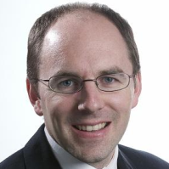
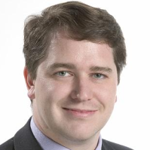
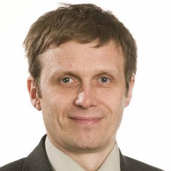
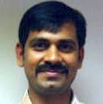
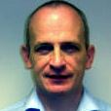

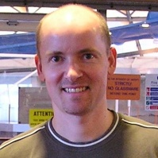
Meet the team
Developers
  Russell Taylor
  Roman Tolchenov
  Sri Nagella
  Ronald Fowler
  Matt Clarke
  Anders Markvardsen
Project Manager
  Nick Draper
Consultants
  Freddie Akeroyd
  Stuart Ansell

Slide 8
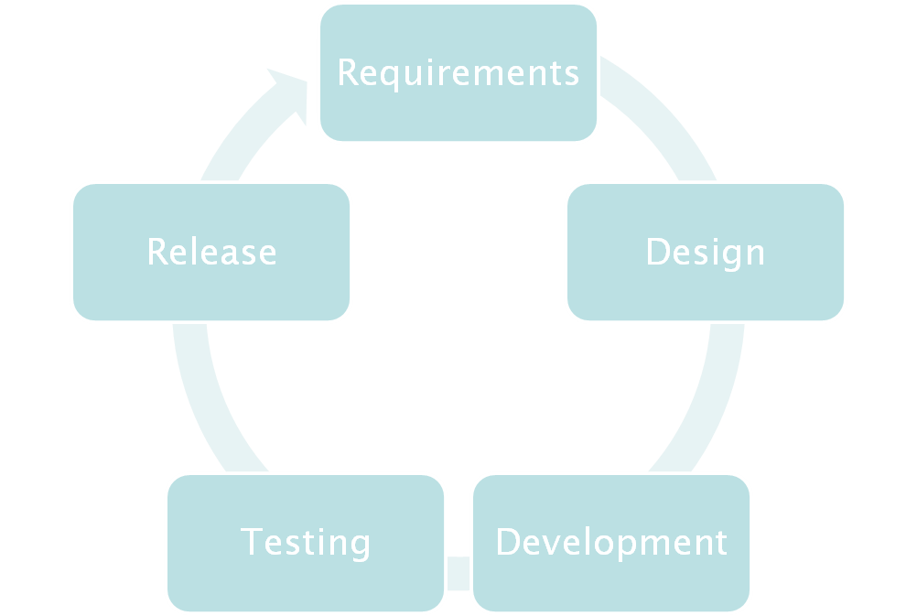

Development Process

Slide 9
User Interfaces
Current Interfaces
  MantidPlot
    A graphical plotting tool
    Providing data interaction and analysis.
  Python
    Command line access and scripting
    Python scripting language
Proof of concept
  Matlab Interface

Slide 10
What Mantid can do now
Data Input
  Raw files and associated log files
  Direct DAE input
  Instrument definition files
  Muon Nexus files
Internal Data Structures
  1D and 2D workspaces
  Managed 2D workspaces for large volumes of data
Instrument Definition
  Full definition of all components
  location and shape
  Loading from XML files or RAW files

Slide 11
What Mantid can do now
Algorithms
  Simple binary mathematical operations
    +, -, *, /
  Integration
  Rebin – 3 variants
  ConvertUnits
    TOF, λ, energy, d-Spacing, q, Q², Energy transfer (meV and 1/cm)
  Grouping of detectors / Marking detectors as dead
  Diffraction algorithms
    AlignDetectors, DiffractionFocussing
  Curve Fitting – Various equations

Slide 12
Areas currently under development
3D Visualisation of the virtual instrument
Further algorithms
  Crystallography and Muons
More flexible curve fitting
Wider NeXus support
Matlab interface
Improved handling of large data files
Linux RPM installation of Mantid
User Documentation

Slide 13
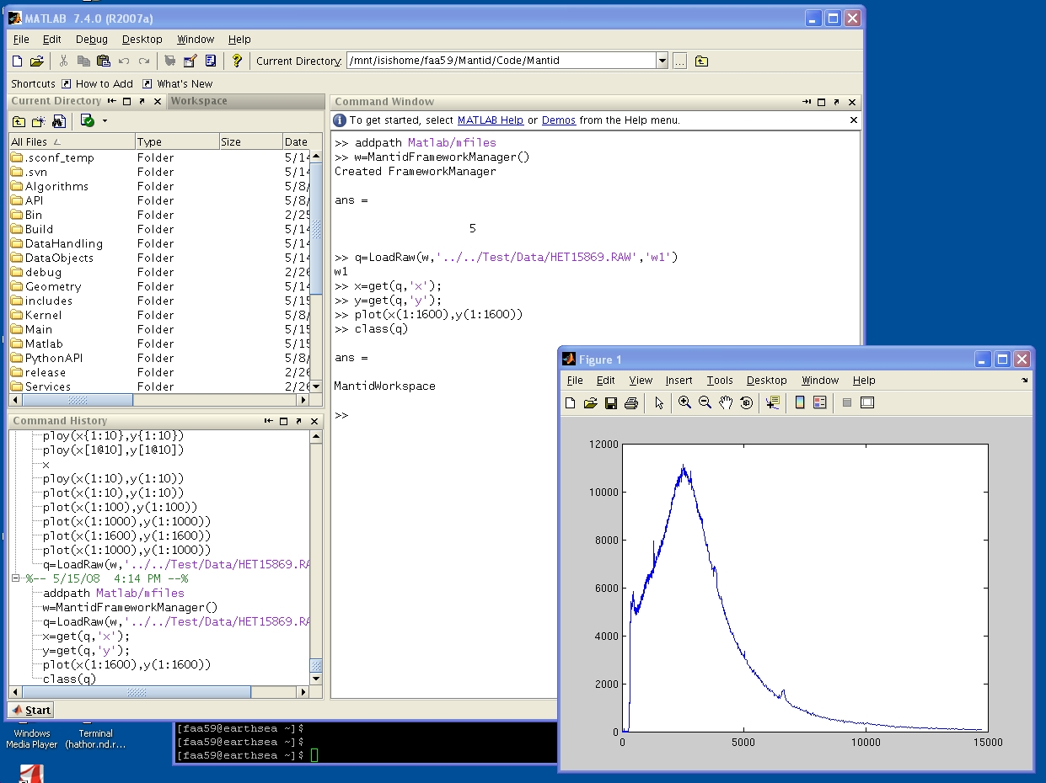
Proof of Concept - Matlab Interface

Slide 14
How to download Mantid
Mantid web www.mantidproject.org
Download Page
  Join the mantid-announce mailing list
  Confirm you subscription
  After joining you will be sent a mailing list password
  you will also need to use this password to access the file download area
The mailing list is to allow us
  To keep track of who has downloaded Mantid
  To inform users of new versions of Mantid
Currently only available for Windows
Linux version available soon

Slide 15
Further Information
Project Web Page
  www.mantidproject.org
Project Introduction Document
  http://svn.mantidproject.org/mantid/trunk/Documents/Requirements/Project%20Introduction%20Document.doc
User Requirements Document
  http://svn.mantidproject.org/mantid/trunk/Documents/Requirements/URD.doc
Architectural Design Document
  http://svn.mantidproject.org/mantid/trunk/Documents/Design/Architecture%20Design%20Document.doc

